Slide 1

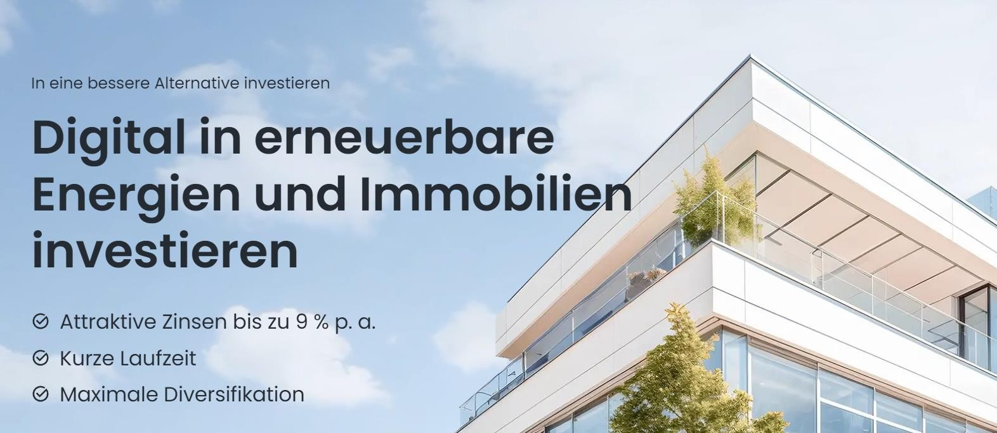

Crowdfin24: Exporo business model in Turkey
TOGETHER WE WILL THE TURKISH EXPORO
1.1 billion € Mediated capital
690 million € Capital repatriated
  575 Projects financed
up to 9 % Fixed interest p. a.

Slide 2











DIGITAL
BE A PART OF THE
CROWDFUNDING
REVOLUTION
Revolutionising the way investment projects are funded
Headquarters
EN
Sector
Real estate crowdfunding
Year of foundation 2020
Legal form
UG
Completed Vol.
ca.19mo. €
Funded projects
43
FTE
Number
9
An exciting investment opportunity

Slide 3





PERFORMANCE
Digital crowdfunding The choice is yours!
also for other investment classes, investment licences and regulations
Social Commerce Digital Marketing Licensing
Blockchain setup for your business funding project
Digital credit processing
Technicised investments in
Profit participation certificates Bonds Real estate fundings

Slide 4

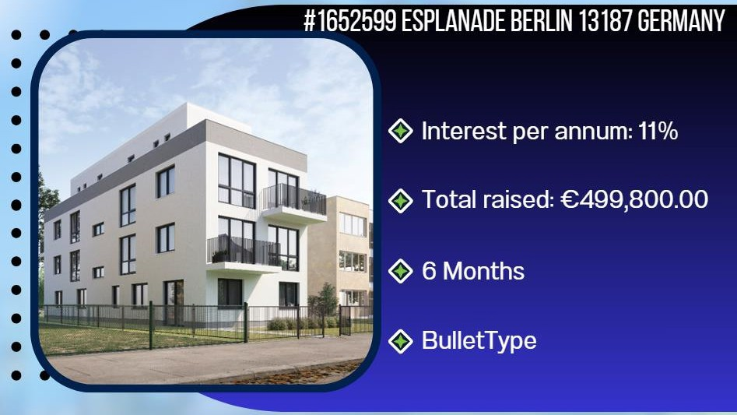
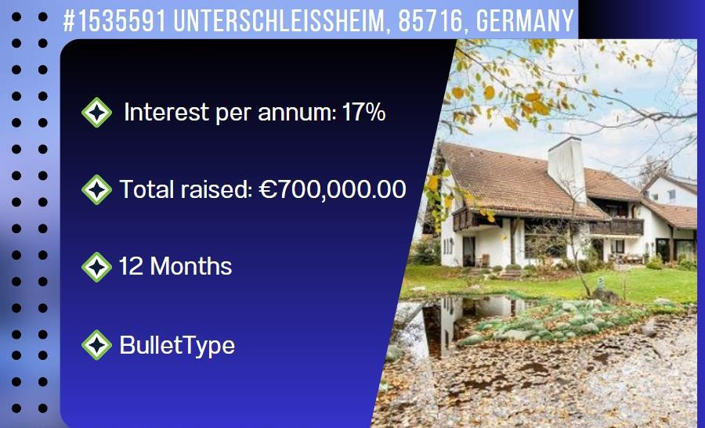
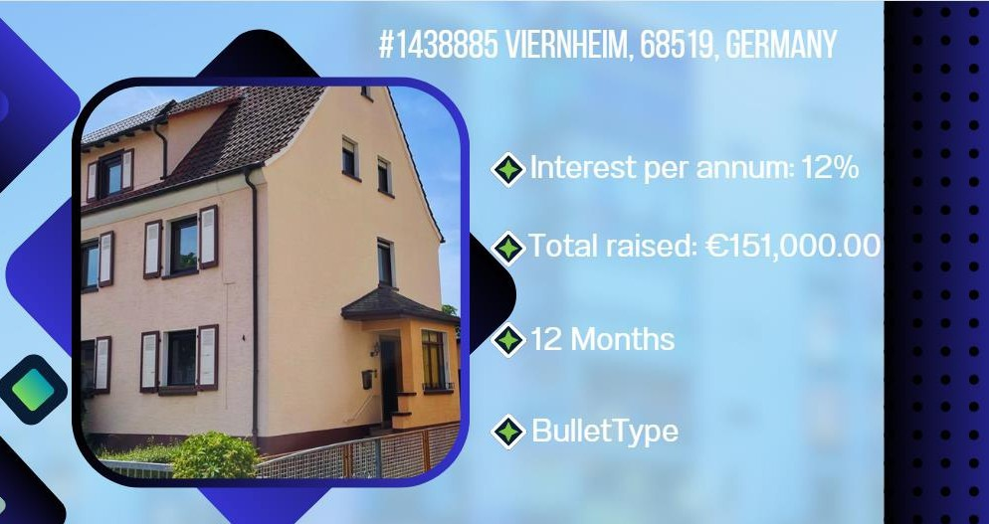
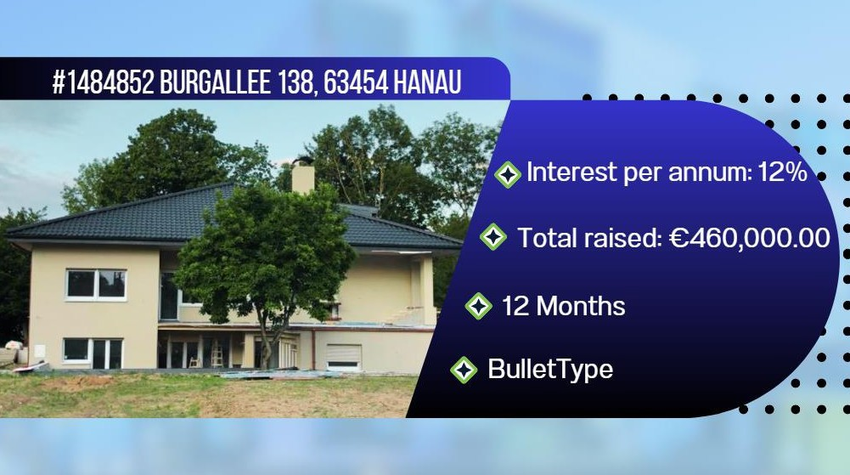
PUBLISHED PROJECTS

Slide 5






WHAT WE HAVE ACHIEVED SO FAR
ImmoEX has been involved in the placement of 43 fundings and has built up great expertise in the process.
ImmoEX has placed approx. € 20 million
ImmoEX has approx. 100 fundings Structured according to the KIIS
- EU standard
Every second person books a second time our services!
The recommendation rate ImmoEX is at 87%

Slide 6





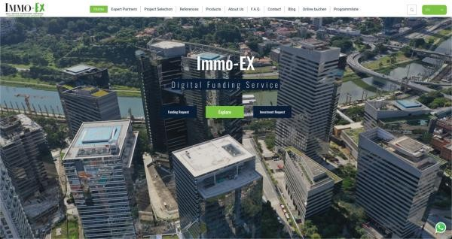



Welcome to our International Platform
/Funding Service

Slide 7


















WHY CROWDFIN24?
Businesses need money for projects such as real estate , purchases, developments, start-ups, bridge and follow-on financing.
Investors have money but no time to check projects / paperwork, regulations, etc. are a constant challenge.
The result is that far too few companies receive financing, which is then very difficult to plan, and this endangers livelihoods.
The over-regulation o f financial markets is a global problem and leads to a slowdown of all investment projects.

Slide 8
















HOW DOES IT WORK?
Your fundings and projects are optimally prepared on a blockchain platform in order to present them to our investment funds.
ImmoEx and Crowdfin24 follow the approach that carefully screened and selected projects are presented to the investors / lead investors under the so-called funding selection.
Only when 30% of the commitments for an investor deal have been closed is the project advertised and further capital raised using our channels.
- Lead and investor marketing
advertised.
As a result, it is ensured that a plannable and timely filling of your project is achieved and the money is available promptly, the shares are subscribed, shares are sold.

Slide 9













The financing mix makes the difference
How Crowdfin24 structures a financing
Scenario
1Scenario 2
Capital requirement: € 1 millionCapital requirement : € 1 million
F K
FK
EK
Gap
mezzanine equity 200,000
Required equity capital 300.000€
Required equity capital 300.000€
€
EK
available Equity
100.000 €
EK
existing equity capital 100.000€
Bank refuses loan due to Basel IV
Bank approves loan

Slide 10



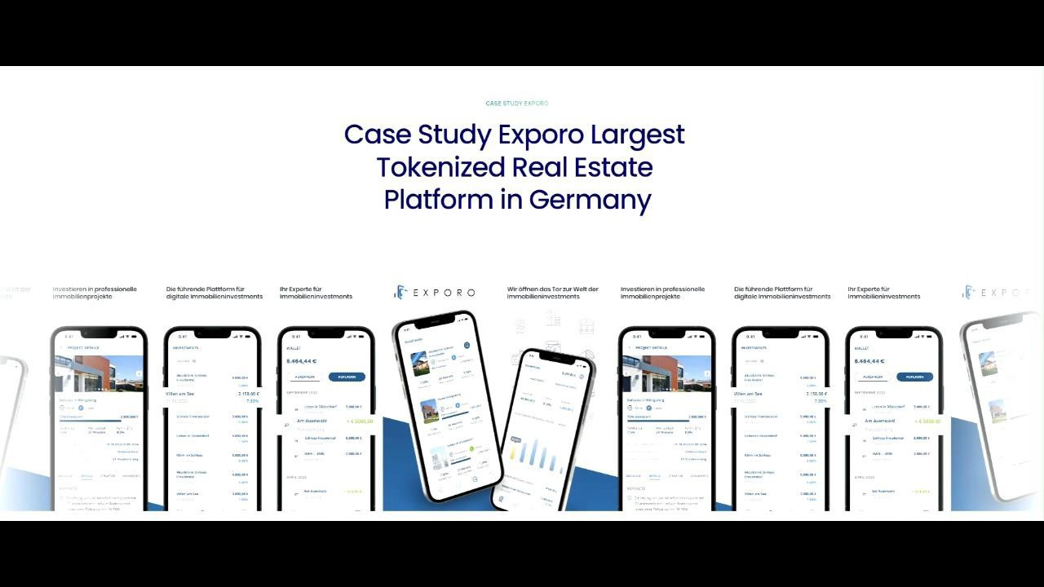
Crowdfin24 platform with white label solution

Slide 11



Features of the crowdfunding platform
Platform reliability
Investment security: Your invested amount secured by Takasbank (escrow) and the corresponding payments are managed by Takasbank and transferred to the project owner.
Binding contracts: Our platform ensures binding contracts between investors and Project initiators.
Security of funding
Mortgage security: Each promoter must accept a mortgage that is less than the current market value of the property lies, and an independent real estate appraisal is mandatory.
Independent valuations: Independent appraisers prepare value reports that ensure an objective valuation. These reports contain comprehensive information on the condition of the project before and after financing.

Slide 12




Features of the crowdfunding platform
Win-win situation
Real estate investment opportunities: Investors can invest in
invest in real estate projects and benefit from increases in value and rental income. This allows investors to diversify their portfolio.
Funding for project initiators: Project initiators receive the funding they need to continue their
real estate projects and to participate in the profits of their projects.
Real estate
Focus on real estate: Our platform is based on specialised in real estate projects.
Project selection criteria: Projects are selected according to strict criteria in order to minimise the risk for investors. We make sure that the projects have a solid foundation and offer a promising return.
Control system
Ongoing updates: Projects provide current information and developments on an ongoing basis in order to keep investors up to date. This enables investors to monitor transparently
of their investment.
Precise financial management: Financing is released gradually to ensure that projects are financed efficiently and investors have security.
Systematic monitoring and communication: Investors have systematic access to information about the progress of the projects and can actively participate in the community. Information is regularly exchanged via blog posts and other means of communication.

Slide 13


Crowdfin24: Exporo business model in Turkey
TOGETHER WE WILL EXPORO THE TURKISH!
According to our research, there is no comparable platform like Exporo in Turkey
With Fracion Mission as our partner, we have the most proven and modern app technology , tested
Multilingual and easy to customise for use.
  People should be able to choose to have a Euro Wallet and invest in our projects in Germany or later to invest in national Turkish projects.
There is already a Turkish platform, Timondro, with 6 offices in the Turkish centres.
who advises us and cooperates with us.
  Our team is experienced after 100 fundings of which 43 have been placed.
now all the next step.
We are also talking to a Czech bank and other interested parties about cooperation. We
see an exit in the sale

Slide 14
























References
These references and many more come from our activities as real estate and financing brokers.

Slide 15




Our motto
Let us
TOGETHER
digitised
their
Projects
realise
Contact
Peter Schless
CEO
+49 1741632818
peter@immo-EX.com
Immo-EXistheofficial e-ValuatePartner

